Slide 1
How We Can Evaluate Our Code?
By: Iman Khani Jazani
AI and Data Specialist, Business Developer | AiHum
Adjunct Professor | Sharif University of Technology
Senior Data Scientist, Community builder | Adin

Slide 2
Last Lecture
Short Presentations
Review OOP with examples
Our futuristic library
Application of Programming in the Digital Age!

Slide 3
Today
Short Presentations
Review the last lecture
حضور و غیاب
عکس یادگاری
Why do we need test? Is it necessary?!
How to implement in Python?
Application of Programming in the Digital Age!

Slide 4
Together
Send your feedback about the class whenever you want!

Slide 5

Contact me
Gmail: ImanKhaniJazani@gmail.com
LinkedIn: https://www.linkedin.com/in/ImanKhaniJazani/
Telegram: @IKJ1992

Slide 6
Short Presentations

Slide 7
Review the Last Lecture

Slide 8


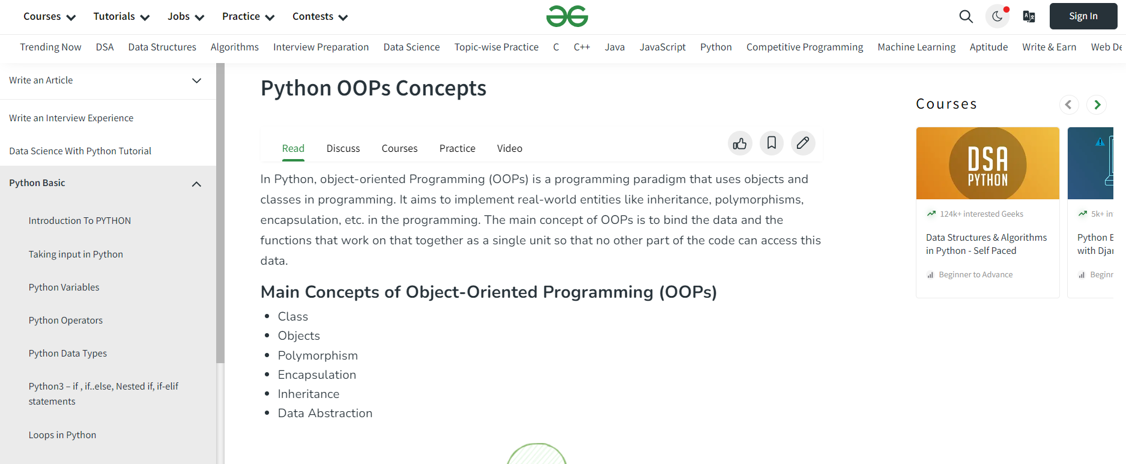
Check it again!
Notes:
https://www.geeksforgeeks.org/python-oops-concepts/

Slide 9


Our library 😉

Slide 10
Why do we need test? Is it necessary?!

Slide 11
Different types of testing strategy
Manual
Automatic
Unit test
Integration test
Can you suggest other strategies?

Slide 12
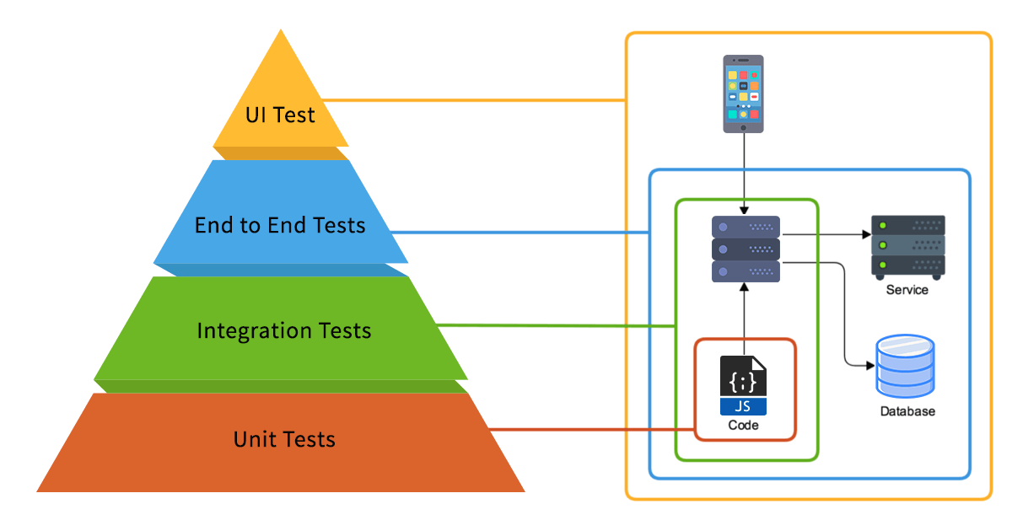
Different types of testing strategy

Slide 13
Assertion

Slide 14
Our library 😉

Slide 15
Application of Programming in the Digital Age!

Slide 16
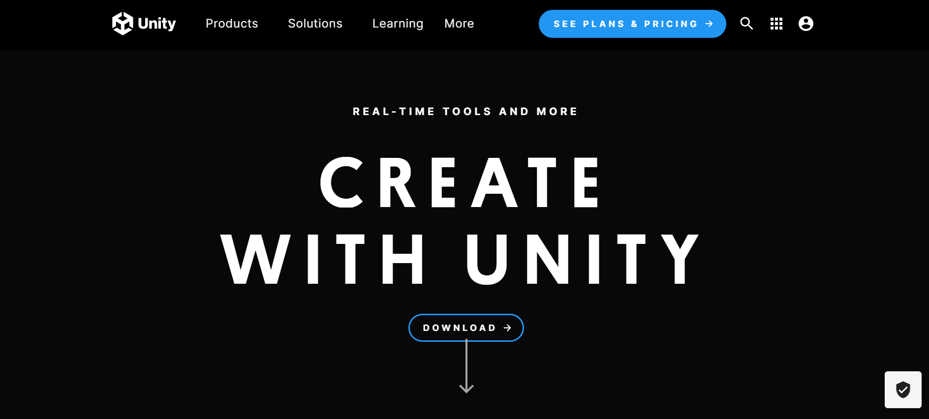
Unity!
Notes:
https://unity.com/

Slide 17
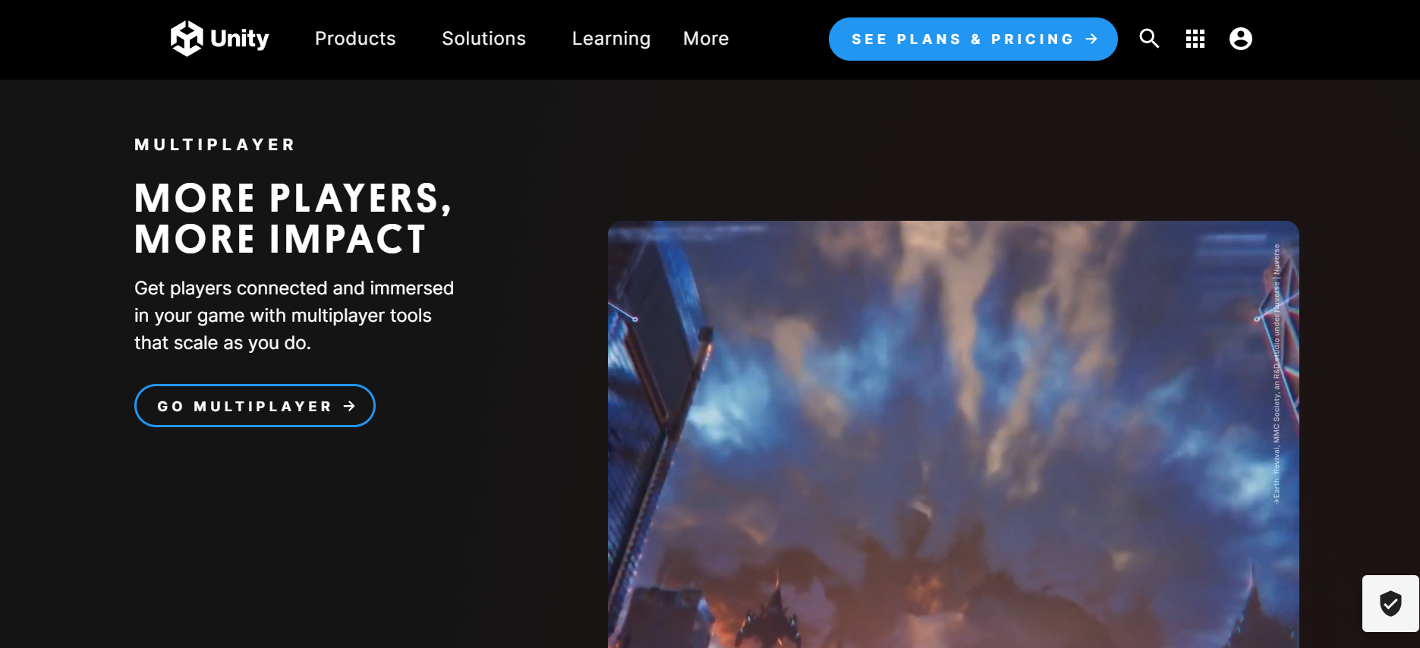
Unity!

Slide 18
Lecture Resources
https://realpython.com/python-testing/
https://machinelearningmastery.com/a-gentle-introduction-to-unit-testing-in-python/

